Slide 1
Competencias previas
Programación Orientada a Objetos
Ing. Arturo Hinojosa Ramírez
Reto numero 2

Slide 2

Strange Planet
On a very strange planet, minutes are 50 seconds, hours are 70 minutes, and days are 12 hours. Since you plan to go on vacation to that planet, you would like to have a clock that, given a number of seconds, displays the number of days, hours, minutes and seconds of that planet.
For example, for s = 3553 0 days, 1 hour, 1 minute, and 3 seconds have elapsed. Write a program for your watch to work properly.

Slide 3
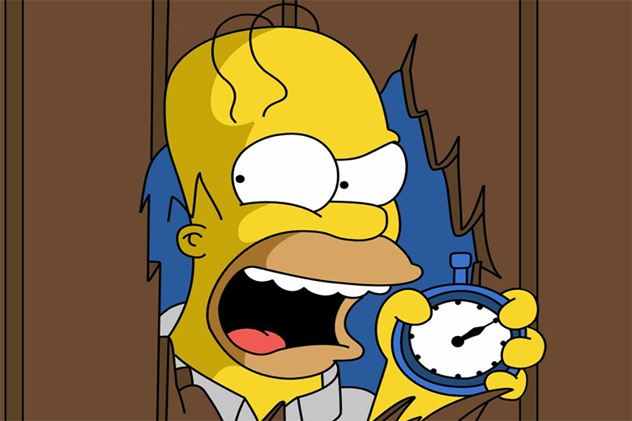
Input s integer
s = 3553
0 days,
1 hour,
1 minute,
3 seconds

Slide 4

Input s integer
s = 3553
m = 3553 / 50
m = 71.06
s = 3553 % 50
s = 3
h = 71 / 70
h = 1
m = 71 % 70
m = 1
1 m = 50 s
1 h = 70 m
1 d = 12 h
d = 1 / 12
d = 0
h = 1 % 12
h = 1
0 days,
1 hour,
1 minute,
3 seconds

Slide 5
start
d = h / 12
Seg, d,h,m,s integer
h = h%12
seg
d,h,m,s
m = seg / 50
end
s = seg % 50
h = m / 70
m = m % 70

Slide 6
Leap year
Program that reads a year on the keyboard and checks if it is leap.
A year is leap if it meets the following: it is divisible by 4 and it is not by 100 or if it is divisible by 400.

Slide 7
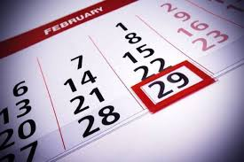
Input
1000
1004
1005
1200
Output
28
29
28
29

Slide 8
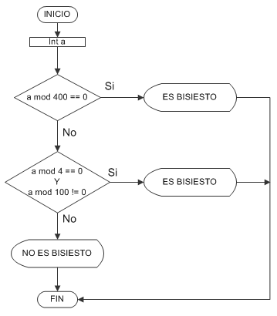
29
29
28

Slide 9


Slide 10
Minors Adults
Input
1999
2005
1969
1950
2002
Output
Mayor de edad
Menor de edad
Mayor de edad
Mayor de edad
Mayor de edad

